Slide 1
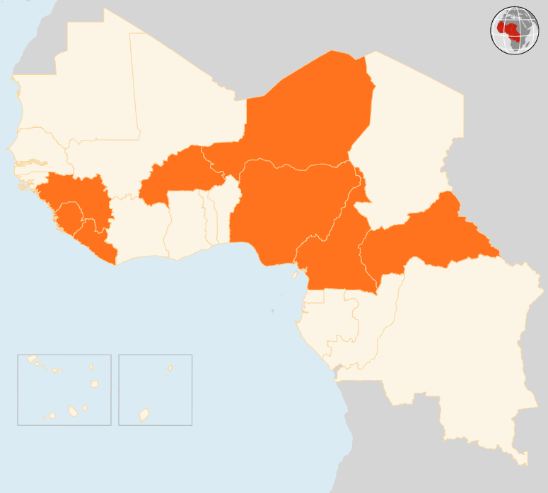

22 - 28 September 2015
BURKINA FASO
DISARMAMENT STALLS
The presidential guard forces who overthrew Burkina Faso’s transitional government before relinquishing power are refusing to give up their arms, the government announced on 28 September, two days after launching the disarmament. The army has surrounded the presidential guards’ barracks and banned traffic to the area.
GOVERNMENT REINSTALLED
On 23 September, transitional President Michel Kafando and his government were reinstated, ending a coup by the presidential guard forces a week earlier. The government has ordered the dismantling and disarmament of the presidential guard and frozen the assets of the coup leader.
CAMEROON
7 KILLED IN ATTACKS
At least seven people were killed and several houses burned down on 26 September during an attack by suspected Boko Haram fighters on Tchika town in the Far North Region. Separately, a double bombing was reported on 22 September in the district of Gozodou Kolofata, while clashes between the Cameroonian army and the militants reportedly occurred in Amchide area on 25 September.
CAR
OVER 20 KILLED IN FIGHTING, 10,000 DISPLACED
More than 20 people have been killed and scores wounded in intercommunal fighting that erupted on 26 September in the capital Bangui. The clashes have also displaced over 10,000 people, most of whom have sought refuge at the M’poko airport site hosting internally displaced persons. The government has imposed a 6:00 pm to 6:00 am curfew, but the situation remains tense.
NIGER
15 KILLED IN ARMED ATTACK
On 24 September, 15 people were killed, several others wounded and houses torched during an attack by suspected Boko Haram gunmen on a village near the border with Nigeria. The area had been calm for the past two months.
NIGERIA
POLIO NO LONGER ENDEMIC
The World Health Organization on 25 September announced that polio is no longer endemic in Nigeria, the first time that the country has broken the transmission of wild poliovirus. Nigeria has reported no case of wild poliovirus since July 2014, and all laboratory data have confirmed a full 12 months without any new cases. As of 2012, Nigeria accounted for over half of the world’s polio cases. Polio now remains endemic only in Pakistan and Afghanistan.
EVD REGIONAL
4 NEW CASES REPORTED IN GUINEA
On 28 September, Guinea reported four new cases. All the cases are in Forécariah prefecture and are from known chains of transmission. No cases were reported in Liberia and Sierra Leone, which started a new 42-day count-down as of 26 September when the last patients were discharged from a treatment centre.
BURKINA FASO
DISARMAMENT STALLS GOVERNMENT REINSTATED
NIGER
15
DIE IN ARMED RAID
NIGERIA
POLIO NO LONGER ENDEMIC
CAR
7
OVER 20 KILLED IN FIGHTING
10k
DISPLACED
EVD REGIONAL
4
NEW CASES IN GUINEA
CAMEROON
7
KILLED IN ATTACKS
Creation date: 29 September 2015 Map data sources: UNCS, DevInfo, OCHA. Feedback: ocharowca@un.org
The boundaries and names shown and the designations used on this map do not imply official endorsement or acceptance by the United Nations.

